Slide 1
A glimpse at digital communications

Slide 2
We need a method of transmitting 1’s and 0’s over wire, in order for components to share digital data
Parallel Communication
- higher data rates
- more pins/wires
Serial Communication
- lower data rates
- less pins/wires

Slide 3
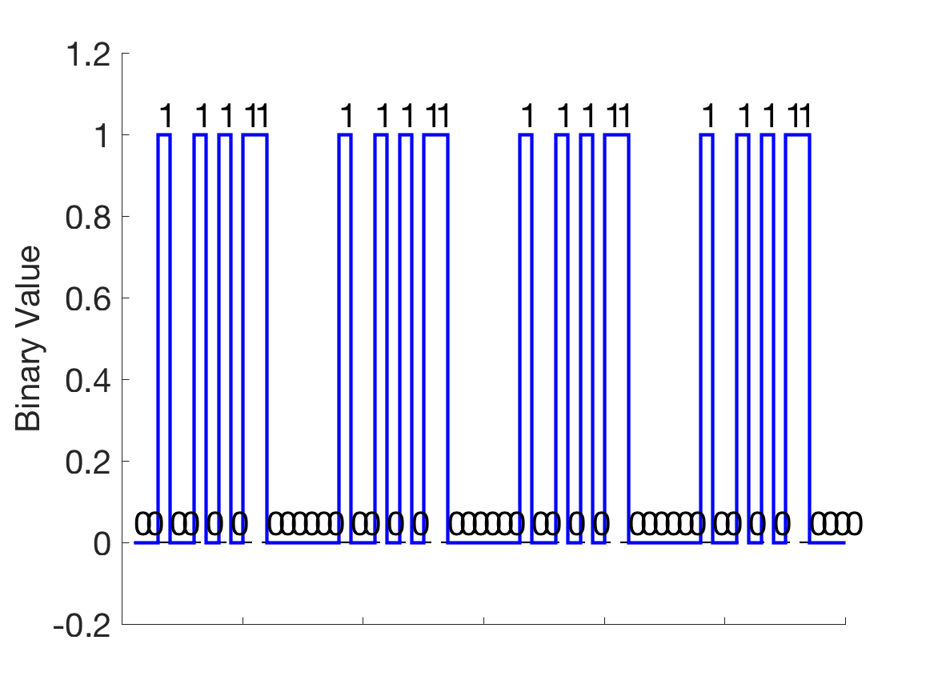
Basically every communication you will use is a serial interface
At its core, serial communication is just a time series of binary data

Slide 4
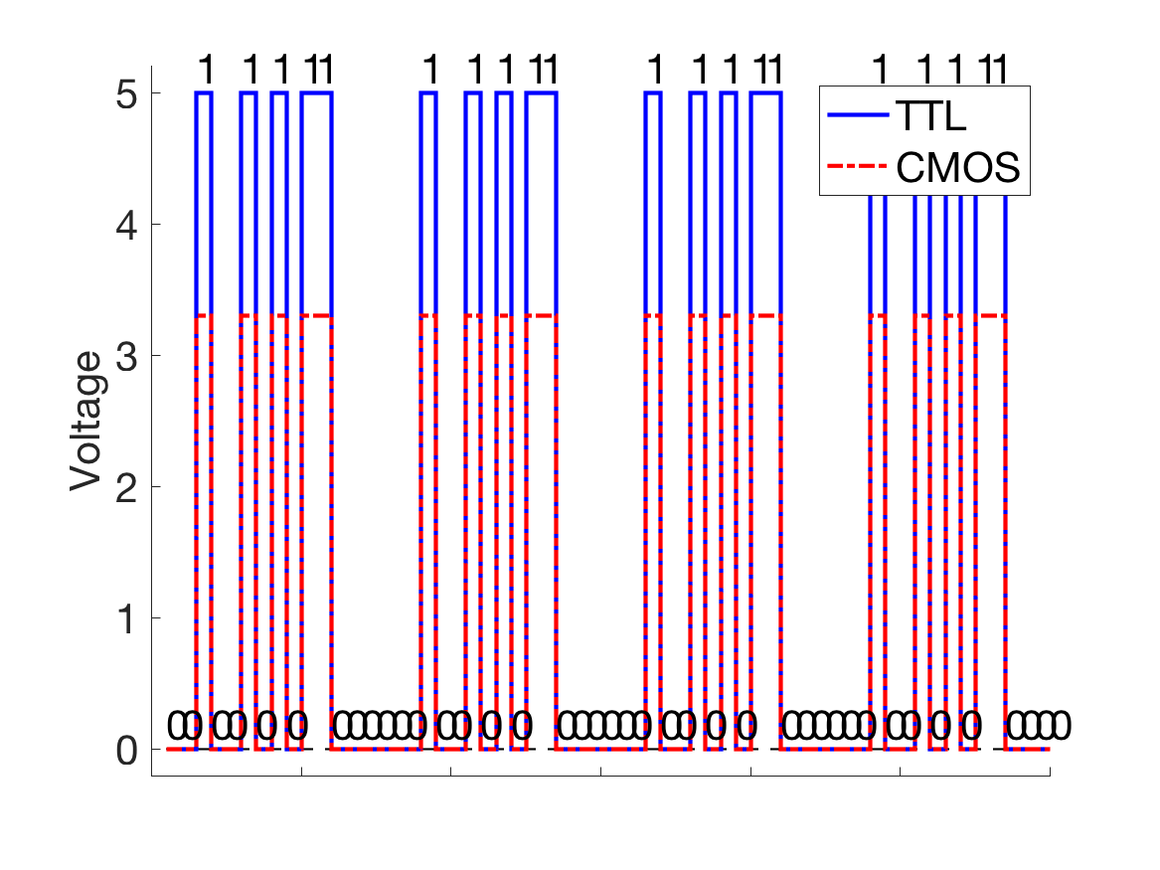
However, voltage levels can vary
Electrically, 1 and 0 must be assigned to a voltage.
Often, these are just 0 (GND) and Vcc of the system

Slide 5
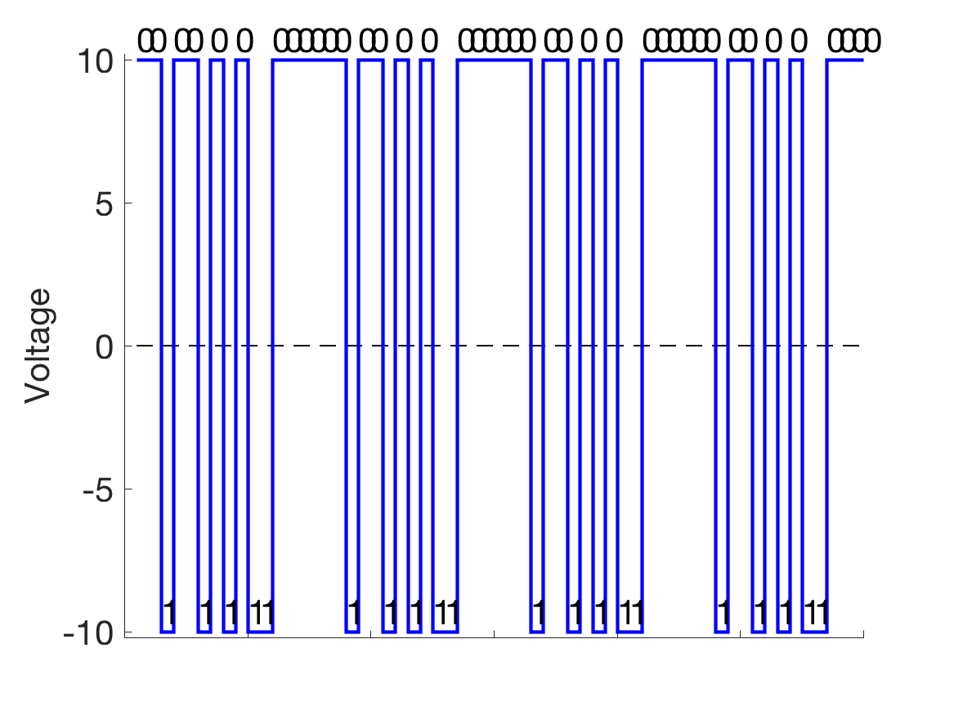
Sometimes, the voltages can be counter-intuitive
There are no rules about voltage assignments, though.
They can be whatever is deemed to make the most sense for the given protocol

Slide 6
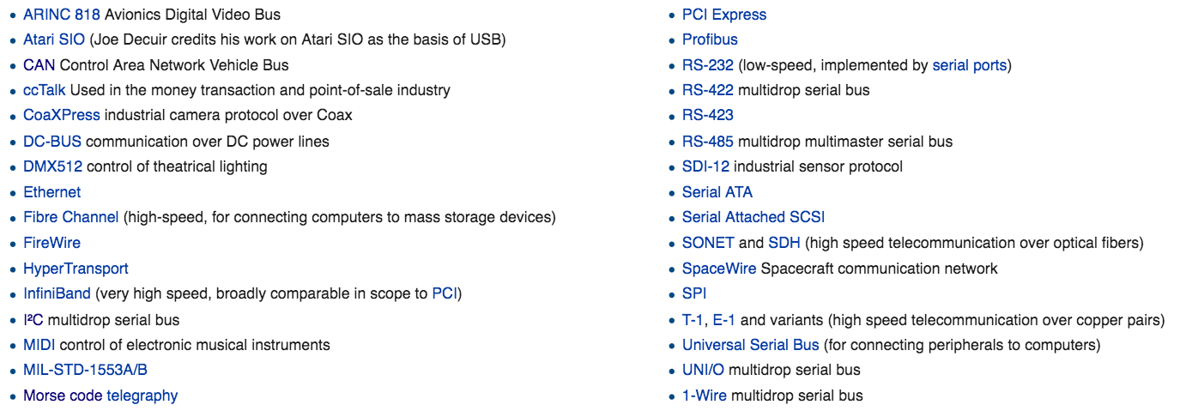
What do we mean by a protocol?
Familiar protocols for communications between devices, and embedded components

Slide 7
Data flow types

Slide 8
Other considerations for choosing protocols
“Share-ability”, i.e. how many components can share a communication line
Synchronous vs Asynchronous, i.e. do the components need a shared timing line (clock)
Transmission distance, i.e. how long can the wire be?
How easy are they interface?
All of these considerations result from a large number of complicated factors. They are each designed to prioritize some combination of aforementioned needs.

Slide 9
Common Embedded Protocols: I²C
(Inter-Integrated Circuit)
(Data)
(Clock)
Synchronous, half-duplex, multi-master/slave.
2 wires only, regardless of the number of compononents.

Slide 10
Common Embedded Protocols: SPI
(Serial Peripheral Interface)
(Clock)
(Data In)
(Data Out)
(Select)
Synchronous, full-duplex, single-master/ multi-slave.
More wires, which generally increase in number with number of components

Slide 11
Common Embedded Protocols: SPI
Multiple Slaves

